Slide 1

Self-Hosting a Student Radio Station
By Ari Carmody
CC-BY-SA 4.0

Slide 2
Some things to clarify
English is my first language (not my fault)
It is also my only language (100% my fault)
The version of english I speak is very different from the version you speak
What’s the craic fein? -> Hello, how are you?
In Ireland University/College are used interchangably
Societies are just clubs but we only call them clubs if they do sports
I’m so sorry I don’t have time for questions but please feel free to chat after the talk!

Slide 3
Radio Soc’s history
Used to broadcast on FM from Dublin’s suburbs
One of the most successful societies in the country
Died during COVID when colleges merged
Re formed in 2024!
Now broadcasting over internet from the city centre
Currently slightly mid

Slide 4
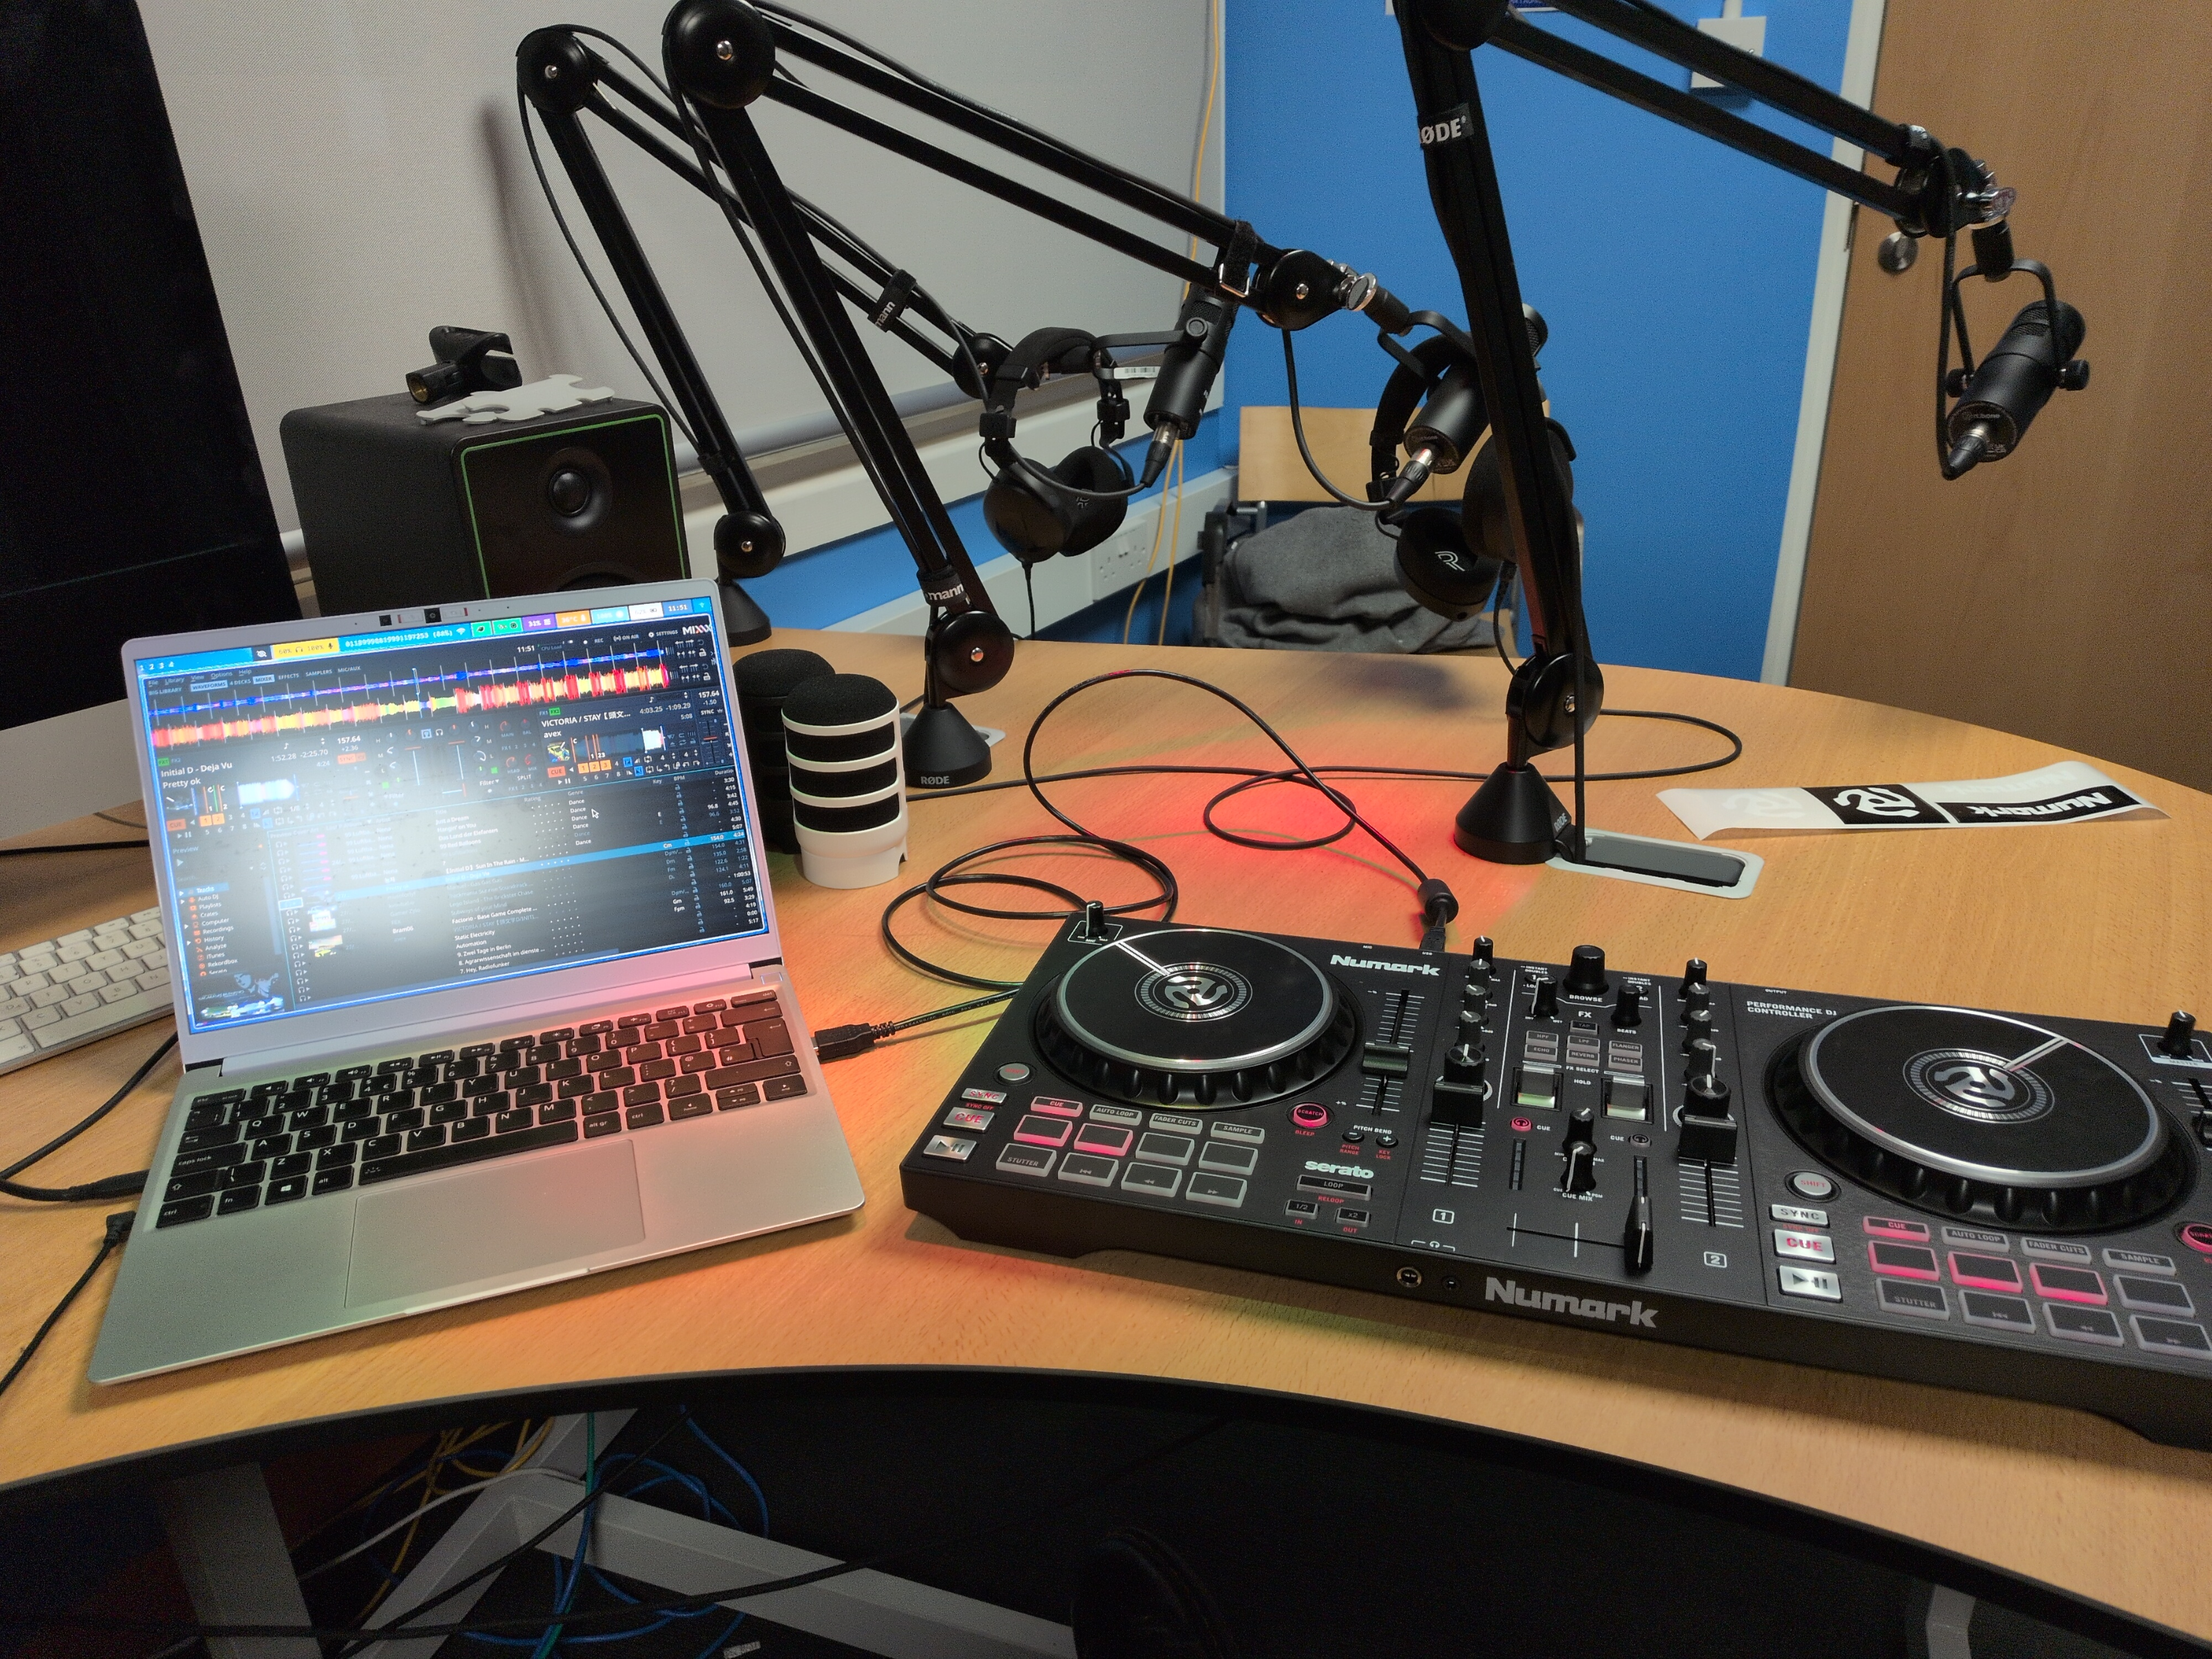
What hardware have we got?
RODECASTER II
Some RODE Mics
Cheap DJ decks
And thats it!
Ari Carmody – CC-BY-SA 4.0

Slide 5
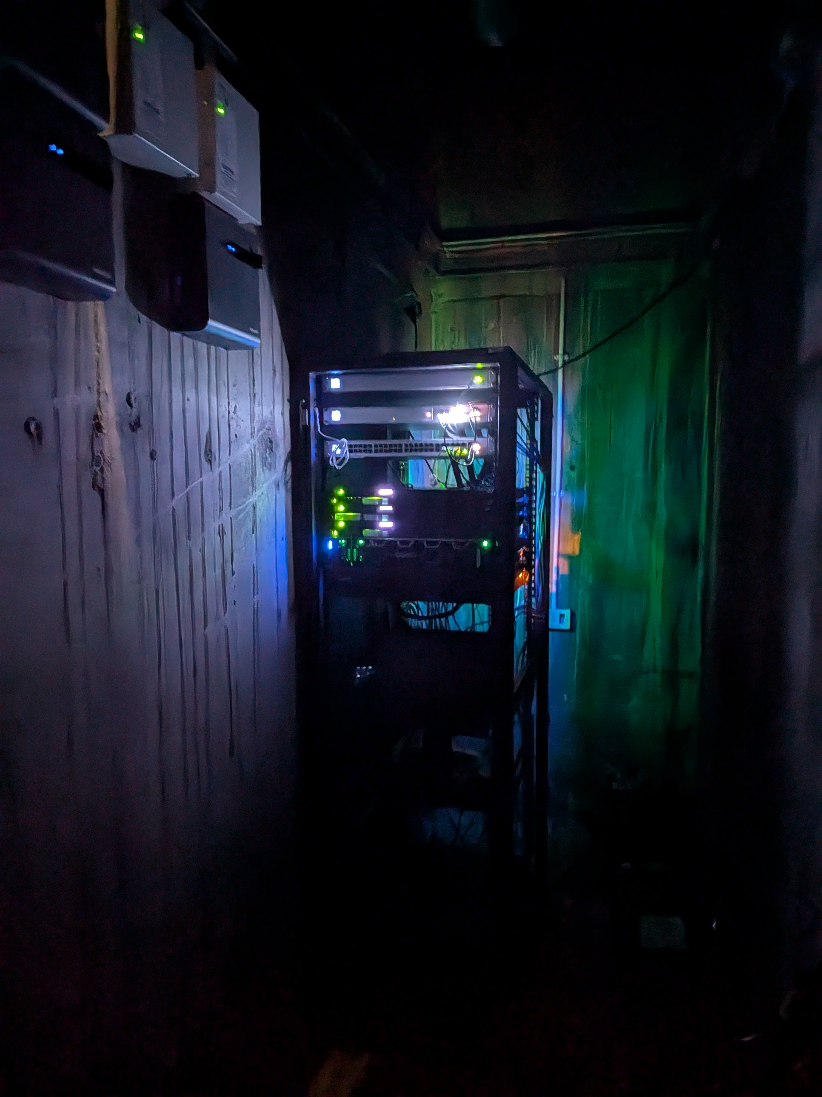
Let’s look at software!
(The thing you’re here for)
Azuracast - Server
Mixxx – Mixer and Decks
BUTT - Client
Ari Carmody – CC-BY-SA 4.0

Slide 6
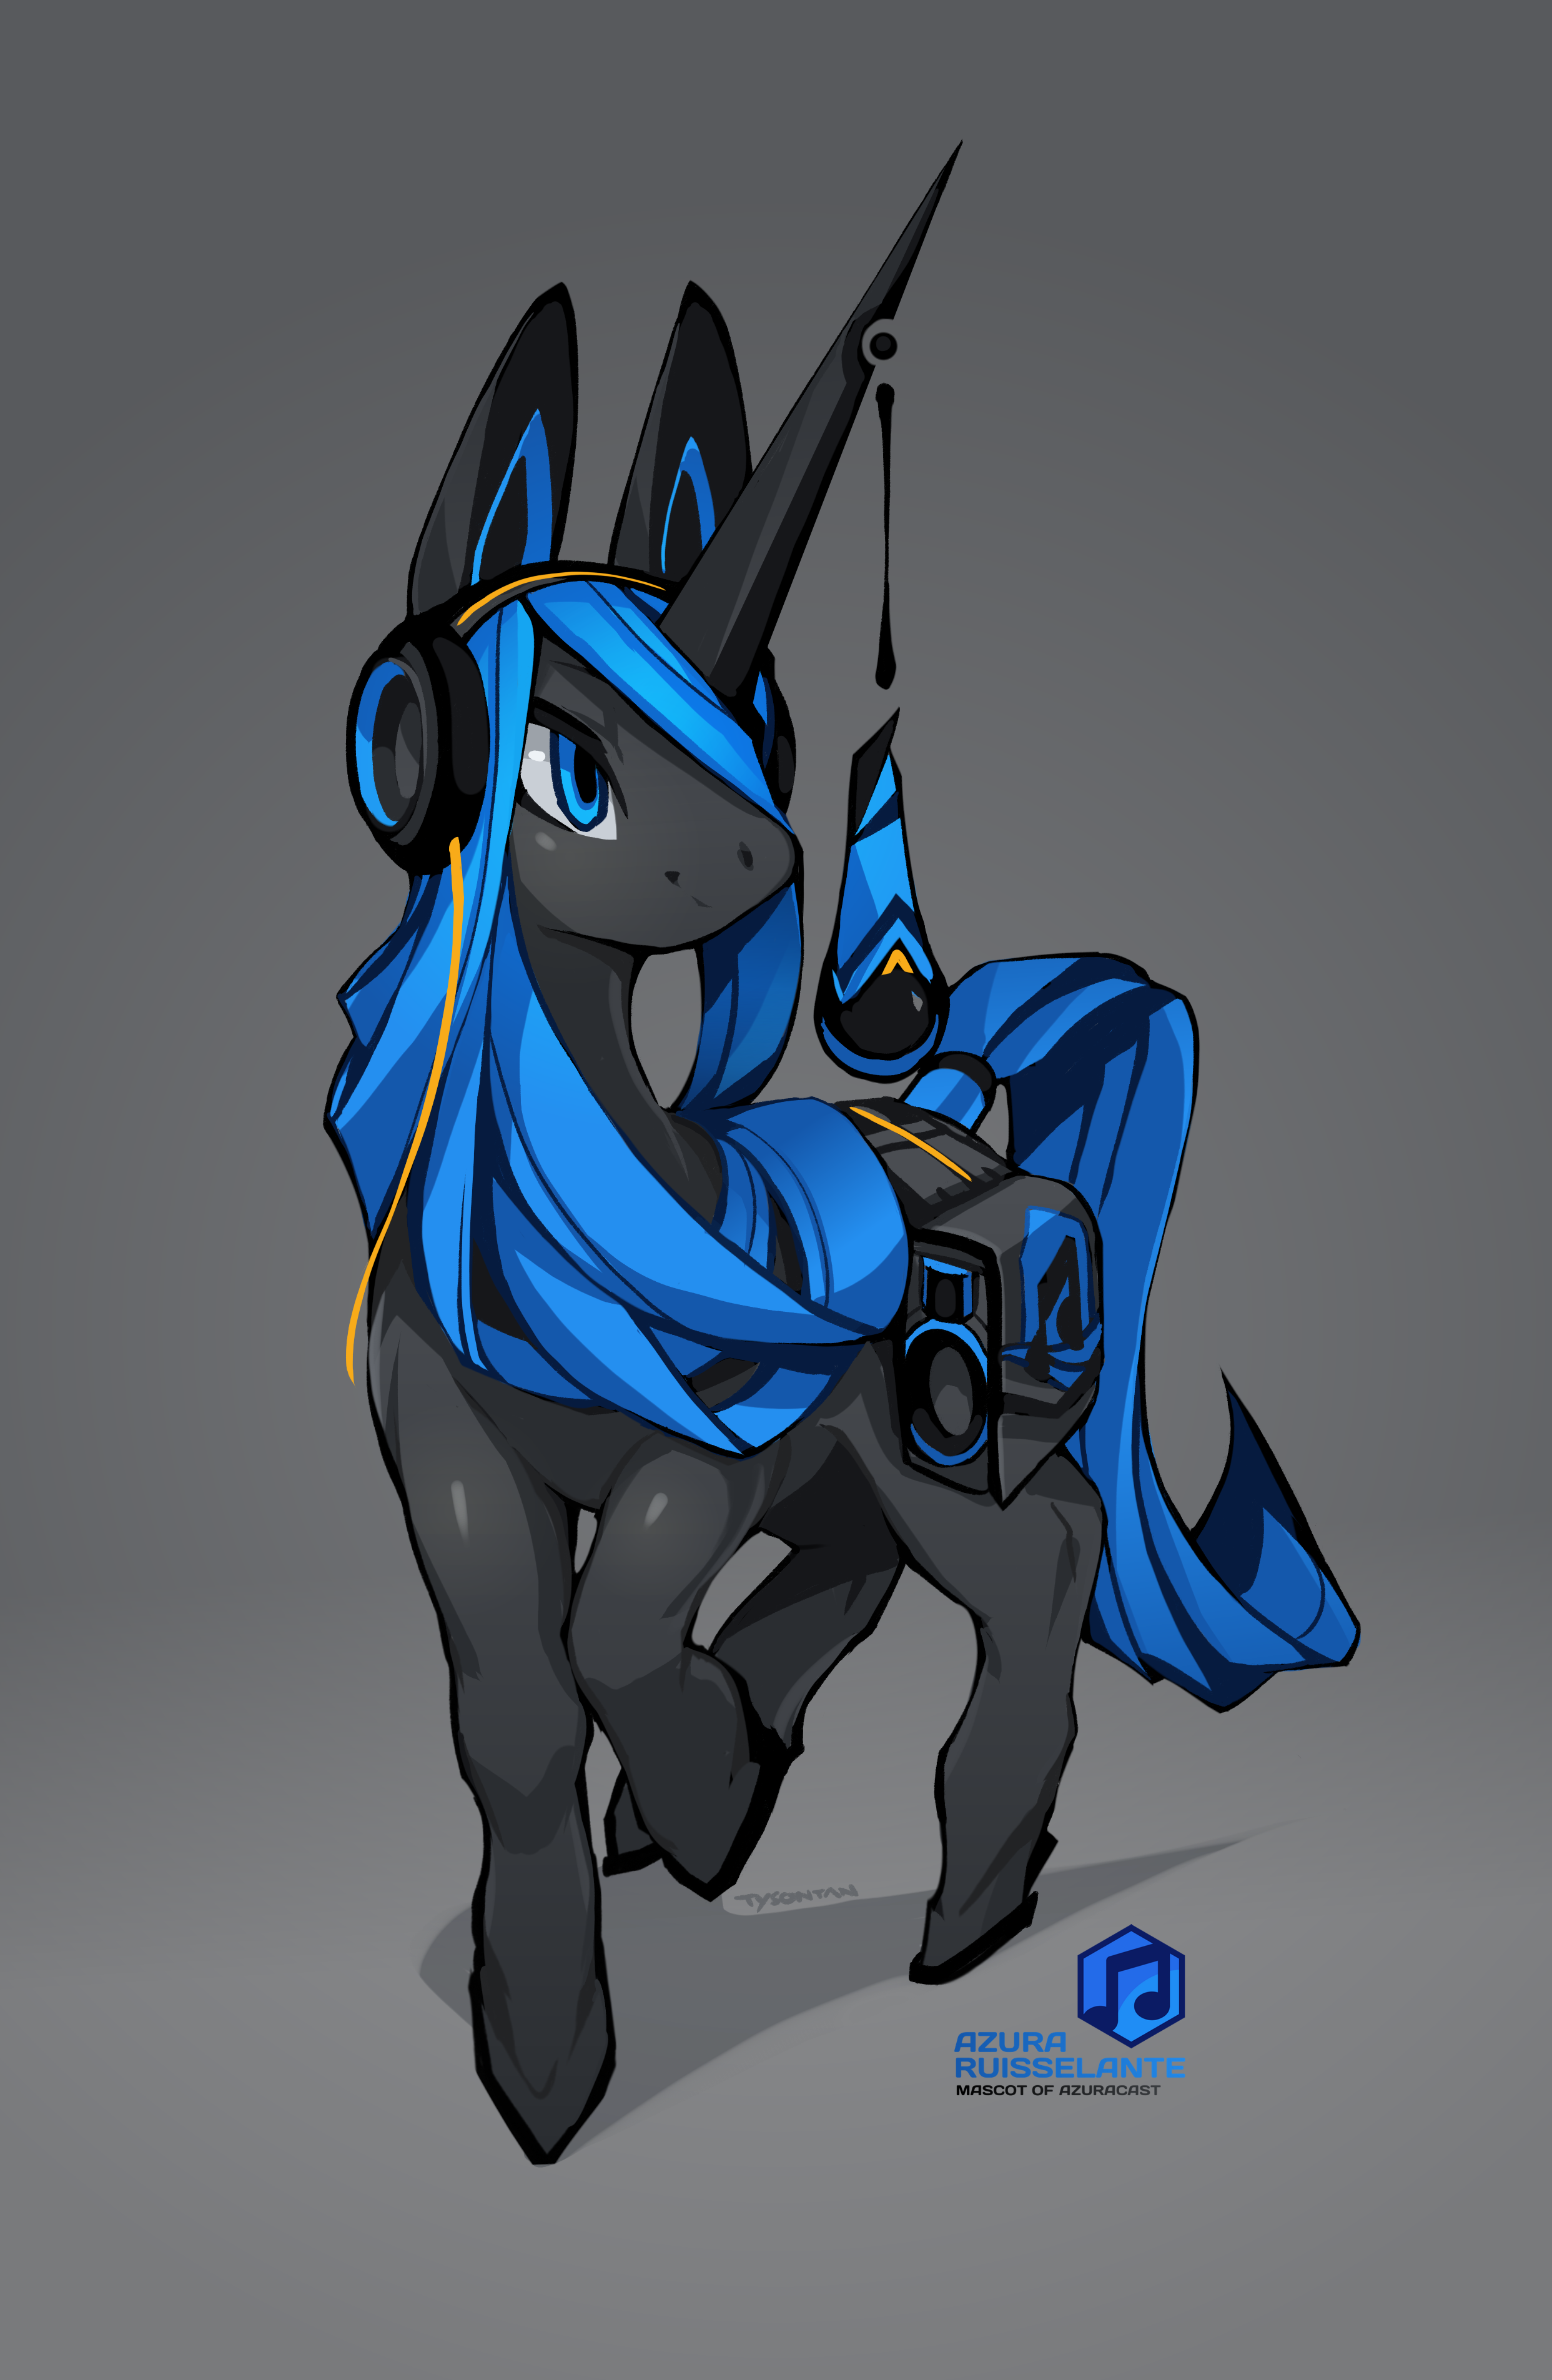

Azuracast (Star of the Show)
Designed for station management
Personally not a fan of the docs (mostly!)
Might be actually be overcomplicated for running just one station
But is very comprehensive – Includes Icecast and Liquidsoap
Tyson Tan – CC-BY-SA 4.0

Slide 7
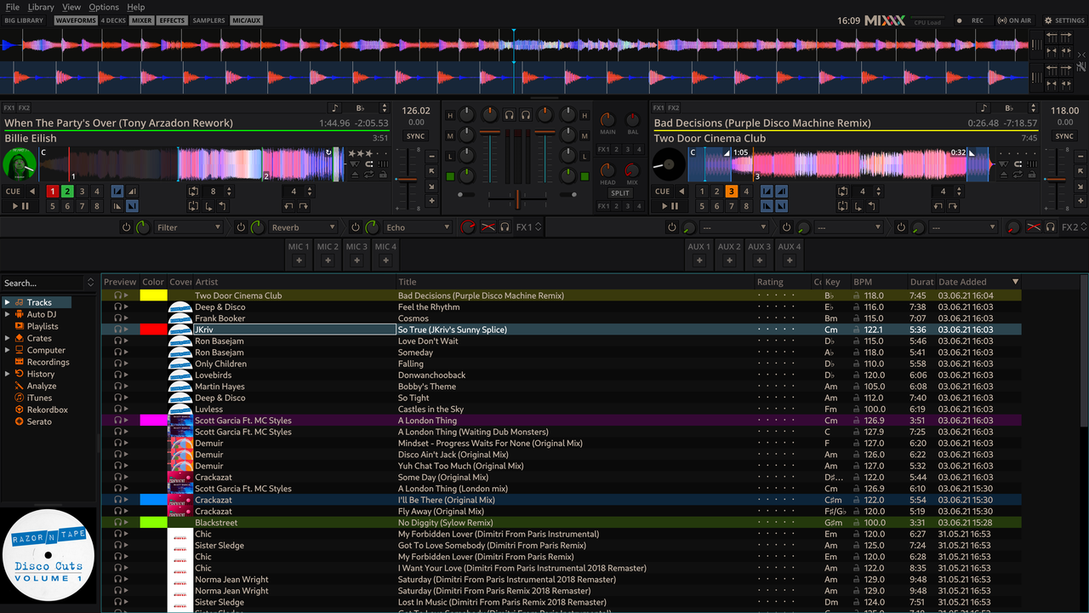
Mixxx
Virtual DJ decks!
Great for getting started with mixing
Supports basically every real deck
Built in streaming
Mixxx Contributors – GNU GPL 2.0

Slide 8
BUTT
Meh
Only available as an appimage
Keeps it simple, stupid and I can’t argue with that

Slide 9
Getting it all working
(Dear god was this harder than we thought)
After convincing the sysadmins to run an untested install script:

Slide 10
Getting it all working
(Dear god was this harder than we thought)
After convincing the sysadmins to run an untested install script:
1. Whoops forgot about cloudflare (Denial)

Slide 11
Getting it all working
(Dear god was this harder than we thought)
After convincing the sysadmins to run an untested install script:
1. Whoops forgot about cloudflare (Denial)
2. TOO MANY FIREWALLS (Anger)

Slide 12
Getting it all working
(Dear god was this harder than we thought)
After convincing the sysadmins to run an untested install script:
1. Whoops forgot about cloudflare (Denial)
2. TOO MANY FIREWALLS (Anger)
3. Maybe it’s just NGINX? (Bargaining)

Slide 13
Getting it all working
(Dear god was this harder than we thought)
After convincing the sysadmins to run an untested install script:
1. Whoops forgot about cloudflare (Denial)
2. TOO MANY FIREWALLS (Anger)
3. Maybe it’s just NGINX? (Bargaining)
4. DNS… (Depression)

Slide 14
Getting it all working
(Dear god was this harder than we thought)
After convincing the sysadmins to run an untested install script:
1. Whoops forgot about cloudflare (Denial)
2. TOO MANY FIREWALLS (Anger)
3. Maybe it’s just NGINX? (Bargaining)
4. DNS… (Depression)
5. Oh it’s working now (Acceptance)

Slide 15
Getting it all working
(Dear god was this harder than we thought)
After convincing the sysadmins to run an untested install script:
1. Whoops forgot about cloudflare (Denial)
2. TOO MANY FIREWALLS (Anger)
3. Maybe it’s just NGINX? (Bargaining)
4. DNS… (Depression)
5. Oh it’s working now (Acceptance)
IT’S STILL NOT WORKING

Slide 16
Problems!
DONT HAVE DEAD AIR!!!
Swapping laptops is very annoying
Sometimes the RODECASTER doesn’t play nice
Dear god get pop filters
I cannot stress enough how bad dead air is like seriously

Slide 17
How did we fix these problems?
Set up a dead air playlist with liquidsoap
Ideally we would have a shared PC but the college won’t give us one
Just keep changing USB ports
We bought pop filters! (wrong ones though)
I’m not even joking if there’s even a few seconds of dead air on your station people will turn it off

Slide 18
Where can you listen to this great station?
radio.societies.ie/public/tudradio
tudradio.neocities.org
@tudradio
Live broadcasts are every Thursday+Friday WHEN WE GET IT WORKING
autoDJ plays music rest of the week

Slide 19
I have questions!
I scheduled this talk too late and need to run for a flight
But you can email my university account at mediachairperson@societies.tudublin.ie

Slide 20
License
Attribution
Dedication
This presentation is licensed under the Creative Commons Attribution ShareAlike 4.0 International license.
To view a copy of this licence, visit https://creativecommons.org/licenses/by-sa/4.0/
or send a letter to Creative Commons, 444 Castro Street, Suite 900, Mountain View, California, 94041, USA.
Photo of Aungier Street radio studio By Ari Carmody Licensed under Creative Commons BY-SA 4.0 International.
Photo of CS++ Server in the dark By Ari Carmody Licensed under Creative Commons BY-SA 4.0 International.
Screenshot of Mixxx 2.3.0 with new default theme LateNight By Mixxx Contributors Licensed under GNU General Public License 2.0
Azura Ruisselante the Broadcaster Unicorn By Tyson Tan Licensed under Creative Commons BY-SA 4.0 International
Thanks to Ruán J. Murgatroyd, Tyler Brady, and all of TU Dublin CS++ for giving up their time to run our station on their server.
Thanks to James Mawdlsey and Tomás O’Mahony for setting up the society and helping grow our station.
Thanks to Nova Hogan for being a great girlfriend and encouraging me to make this talk.
Thanks to Kaytee Beehan for working hard in the socs office
Thanks to the whole FOSDEM crew for letting me speak at their amazing conference!

Slide 21
I have questions!
I scheduled this talk too late and need to run for a flight
But you can email my university account at mediachairperson@societies.tudublin.ie

